Slide 1
Confidential Report:
Sukhinder Singh Cassidy
August 2022

Slide 2
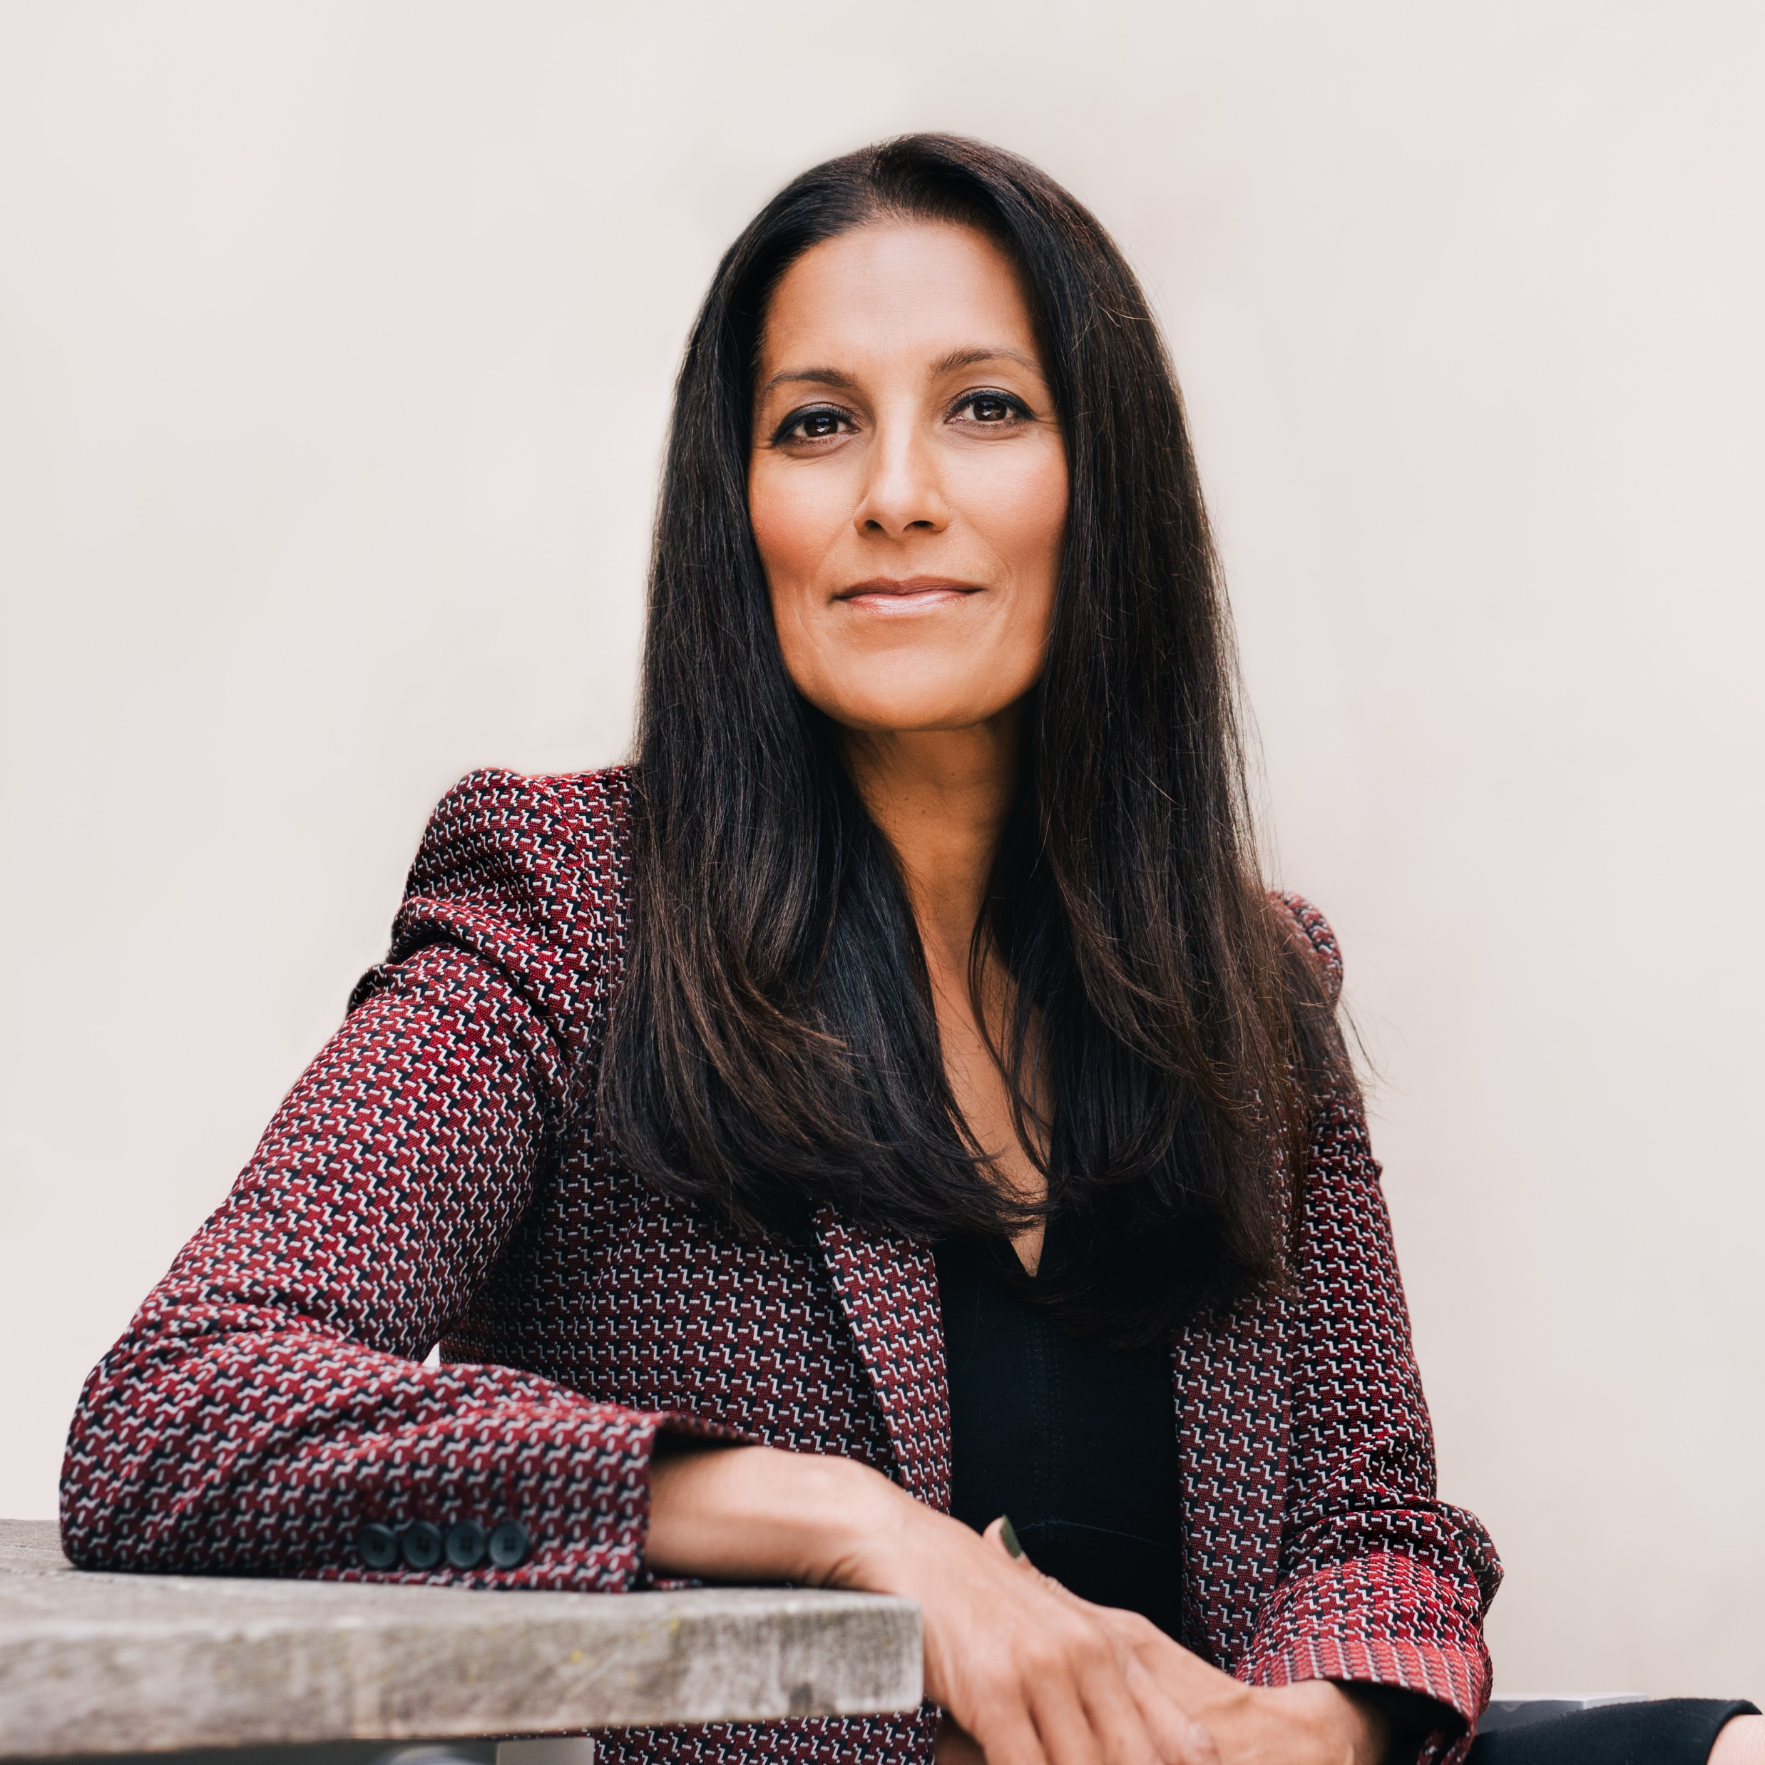
Profile: Sukhinder Singh Cassidy
Sukhinder.singh@gmail.com
+1 415 577 5035 (Mobile)
Location: San Francisco Bay Area
Education
1992 BA, Business Administration – Ivey Business School at
Western University, Ontario, Canada
Executive Roles
2021 – Present ACREW CAPITAL
Operating Partner, part-time
2018 – 2020 STUBHUB
President
2011 – 2017 JOYUS
Founder, Chairman and CEO
2010 – 2010 POLYVORE
CEO
2009 – 2010 ACCEL PARTNERS
CEO-in-Residence
2003 – 2009 GOOGLE
President, Asia Pacific & Latin America Operations
1999 – 2003 ENVESTNET | YODLEE
Co-founder and SVP, Business Development
1998 – 1999 AMAZON.COM (& JUNGLEE)
Business Development Manager
1995 – 1996 SKY
Analyst
1993 – 1995 MERRILL LYNCH
Financial Analyst, Investment Banking
Board Roles
2015 – Present theBOARDLIST - Founder and Chairman
2021 - Present TUNEIN
2021 - Present CANADA DRIVES
2020 – Present UPSTART
2017 – 2022 URBAN OUTFITTERS
2012 – 2018 TRIPADVISOR
2015 – 2018 ERICSSON
2009 – 2010 J. CREW
TBD STITCHFIX
WHY ARE WE PRESENTING THIS CANDIDATE
Sukhinder Singh Cassidy is an experienced executive, digital leader, board member and entrepreneur with 25+ years of experience building and scaling global companies, including Google, Amazon, Yodlee, Joyus and StubHub. Since 2021, Sukhinder has been a part-time Operating Partner at Acrew Capital, where she helped raise their inaugural growth fund in 2021 and makes growth investments. Sukhinder also currently serves as Lead Independent Director at both Upstart (UPST) and Canada Drives, and as Founder and Chairman of theBoardlist. She has previously served as a board member at Ericsson, Trip Advisor, Urban Outfitters, Stitchfix, J.Crew and as an early strategic advisor to Twitter.
From 2018 to 2020, Sukhinder served as the President of StubHub Inc, the leading global ticketing marketplace for live entertainment with over $5bn in annual GMV and $1bn+ in annual revenues. In February 2020, StubHub was acquired by Viagogo for $4bn, in a transaction led by Sukhinder and her team. During her tenure, Sukhinder led StubHub globally and served on eBay’s executive leadership team. There she focused on accelerating the platform’s new products and services, including data analytics, pricing tools, advertising and insurance services, loyalty , and exclusive supply offerings as well as its international business, while driving further efficiencies in the company’s operations. Post the company’s acquisition, from March to June 2020, Sukhinder led StubHub through the COVID-19 crisis, restructuring the company in response to the global pandemic while ensuring the company ‘s longer-term ability to sustain and recover with the live entertainment industry.

Slide 3
Profile: Sukhinder Singh Cassidy
WHY ARE WE PRESENTING THIS CANDIDATE (cont’d)
From 2015 to Present, Sukhinder has served as Founder and Chairman of theBoardlist, a premium b2b talent marketplace she started to connect highly endorsed diverse leaders with board and executive opportunities. Today theBoardlist has grown organically to a platform of over 35k members, has assisted in over 2000 board searches, and has industry leading partnerships with YPO, the Aspen Institute, HBS, Nasdaq, the 30% Club and more. theBoardlist has been profiled in numerous publications including: Fortune, Forbes, the Wall Street Journal, NYT, Bloomberg, Wired, TechCrunch, Fast Company, and USA today and raised its first institutional round of capital in fall of 2020. Sukhinder continues to support theBoardlist’s fulltime team and mission, and act as a spokesperson on topics of diversity in leadership.
From 2011 to 2017, Sukhinder was Founder and CEO of video commerce pioneer JOYUS. JOYUS’s patented shoppable video content and technology has been distributed across the web at leading sites including AOL, the Huffington Post, Comcast, Time Inc, and helped 800+ lifestyle brands create and monetize online video through direct product sales. Sukhinder scaled the company from inception to almost $20m in annual revenues across both retail and marketplace business models, while raising $50m in venture capital from leading investors including Accel, Steamboat and Marker Capital; JOYUS was acquired by native commerce platform StackCommerce in September 2017.
Prior to founding JOYUS from 2010 to 2011, Sukhinder served as CEO and Chairman of the board at the leading social commerce site, Polyvore, Inc, which pioneered the content and commerce model for creators and brands in the fashion, beauty and lifestyle verticals. Polyvore was sold to Yahoo! in 2015 for $300+m.
From 2003 to 2009, Sukhinder was a senior executive at Google, Inc, where she grew and scaled several businesses, including Local & Maps, and Asia-Pacific & Latin American Operations. As President of Asia Pacific and Latin America, Sukhinder was responsible for all of Google’s digital sales operations in both regions, and built the company’s physical presence from less than $100m into a multi-billion dollar business serving users, advertisers and partners across 40 domains and 103 different countries throughout JAPAC and Latin America. Under her leadership the company opened 18 ad
WHY ARE WE PRESENTING THIS CANDIDATE (cont’d)
sales offices, 9 R&D centers, built full cross-functional operations throughout the region and was the fastest growing geography within the company.
Previously Sukhinder was Founder & SVP of Sales and Business Development at leading b2b fintech platform Yodlee (YDLE) from 1999 to 2003. At Yodlee, Sukhinder served as the business founder, establishing the business model and scaling the company to $15m in SaaS revenues annually. While there she achieved over 80% penetration of the top 25 banks and brokerages nationally, as well as relationships with MSN, Intuit and Yahoo. She helped close over $100m in total capital, and served as the company spokesperson with financial regulators and the industry, establishing the company as the defacto data aggregation platform for online financial applications. Yodlee went public in 2014 before being acquired by financial software platform Envestnet in 2015.
Sukhinder started her career in Silicon Valley at Junglee (acquired by Amazon), where she drove business development for the first generation of Amazon marketplace. Prior to Amazon, Sukhinder worked for British Sky Broadcasting (a News Corp company) and in Merrill Lynch’s Financial Institutions Group in New York and London.
For her work in the Internet industry, Sukhinder has been profiled in numerous publications globally, including Fortune, Forbes, Wall Street Journal, Business Week, the New York Times, Bloomberg, Sports Business Journal, Billboard, Vanity Fair, Vogue, Techcrunch, AllthingsD, Ad Age NPR, and numerous leadership podcasts. She has also been profiled in several leadership books, including: “the Money Hackers”, “How Good Leaders Learn”, “Innovation Nation” and “Geek Girl Rising”. She has been named one of the Most Creative People in Business By Fast Company (2017), one of the Top 100 People in the Valley by Business Insider (2016, 2012); a “Woman to Watch” by Forbes (2014), Fortune (2008) and Ad Age (2010); Techcrunch’s first General Management Fellow (2009); and one of the Top 100 Women of Influence in Silicon Valley (2016,2014,2010).
Sukhinder is also author of the Wall Street Journal bestseller, Choose Possibility, Take Risks and Thrive (Even when you Fail), which she wrote in 2020, and was published in August of 2021. She has an undergraduate degree from the Ivey School of Business Administration at the University of Western Ontario, Canada and resides in Northern California with her family.

Slide 4
Profile: Sukhinder Singh Cassidy
INTEREST IN THE ROLE
Since selling StubHub in 2020 and through the COVID pandemic, Sukhinder has considered leaving her career as an operator and focusing on boards and private equity. Recently, however, she has made the decision to return to a CEO role for at least “one more good run”. She is actively considering new CEO opportunities and happens to be at a perfect time to make a decision.
Xero is a company which is particularly interesting to Sukhinder. She is relatively familiar with Xero from past experience, and has watched the company alongside its well-known US competitor, Intuit. The SMB sector is particularly interesting to her, as she both enjoys the blended approach of B2C and B2B required to win as well as the mission-driven aspects of impacting the lives of entrepreneurs. Much of her role at Google and Stubhub focused on the SMB channel, and she feels very comfortable in the space. Lastly, as a native Canadian she has a special affinity for the Commonwealth countries and understands how such cultures can differ from the standard American way of doing things. Notwithstanding the time zone challenges, the fact Xero has deep roots in New Zealand and Australia actually make the opportunity more interesting to her.
Many aspects of the Xero opportunity resonate with Sukhinder. She will be most interested in hearing the go-forward strategy for globalization, particularly with a focus in the US and its competitive environment. She would also like to better understand Xero’s prior efforts in the region, both what worked and what didn’t. None of these challenges or prior experience deter her from the challenge, and of all the CEO opportunities which she has recently considered, the role at Xero is the most appealing and best fit for her own personal skills and ambitions.
AREAS TO PROBE
Sukhinder’s busy board schedule and “celebrity” status in the US tech circles risk being a distraction from a role which will require dedication and a potentially demanding travel schedule. While she has promised to reduce her board commitments after she lands a full-time CEO role, does her schedule allow for the time requirements of this job? Can she balance the demands of a family, boards, and speaking commitments alongside a full-time CEO role for a company in an important transformation?
HELPFUL LINKS
LinkedIn profile: https://www.linkedin.com/in/sukhinders/
Book microsite: https://www.choosepossibility.com/
Wikipedia: https://en.wikipedia.org/wiki/Sukhinder_Singh_Cassidy
Talks at Google, Sept 2021 (video, 1:00:12):
https://www.linkedin.com/in/sukhinders/
Forbes – Diversifying the C-suite, Sept 2021 (video, 2:04):
https://www.youtube.com/watch?v=hrpgUZ5Nzsw
CNN - Diversity in the Tech Industry, Dec 2019 (video, 15:46):
https://www.linkedin.com/in/sukhinders/
Fortune - Making boardroom diversity a reality, Oct 2015 (video, 2:53):
https://www.youtube.com/watch?v=QLUH5PrBRYY
Forbes – Strategy For Building A Dream Career, Sept 2021 (article):
https://www.forbes.com/sites/carminegallo/2021/09/16/a-silicon-valley-ceo-shares-her-strategy-for-building-a-dream-career/?sh=3ed7f8e3ff43
Time – profile and interview, Nov 2017 (article):
https://time.com/5022322/sukhinder-singh-cassidy-sexism-tech/
New York Times – profile and interview, July 2016 (article):
https://www.nytimes.com/2016/07/10/business/sukhinder-singh-cassidy-either-you-manage-me-or-i-manage-you.html

